Slide 1

Drug Review Prediction
Sonali Panigrahi

Slide 2

AI in HealthCare
AI healthcare market, valued at $11 billion in 2021, is projected to be worth $187 billion in 2030.
Applications of AI in HealthCare:
Radiology using Image Recognition
AI-assisted documentation
Robotic surgery
Fraud detection in the healthcare industry
NLP systems can convert spoken or handwritten medical notes into structured electronic health records (EHRs)

Slide 3
Agenda
Problem Statement
Data
Exploratory Data Analysis
NLP & Labels Preprocessing
Modelling
Results
Limitations and Future Works

Slide 4
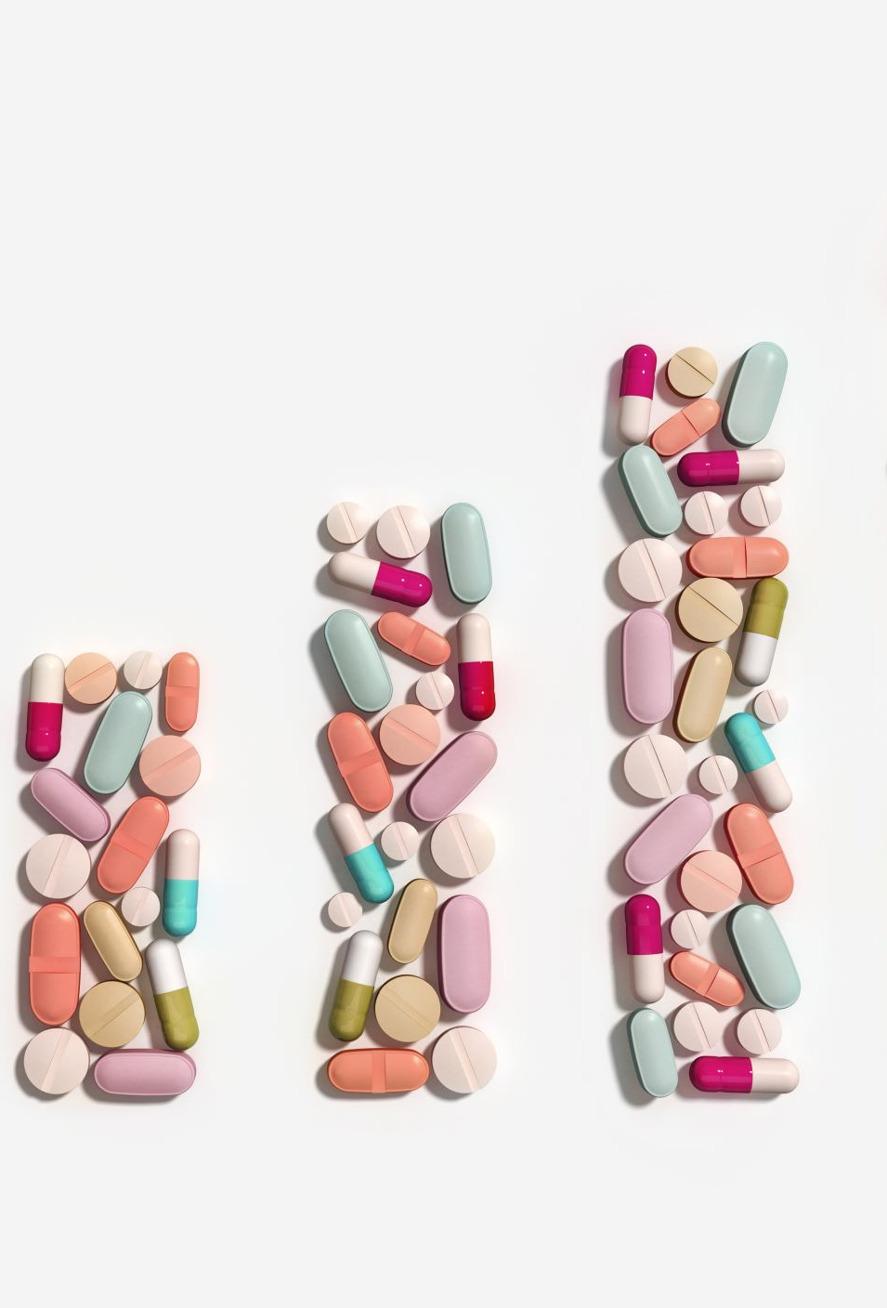
Problem Statement
Performing EDA based on features like reviews, drug name, conditions, ratings and date
Classification of condition using NLP and Machine Learning techniques based on drug reviews.

Slide 5
Data
Data on drug name, condition (disease), rating & patient’s review
~215k reviews: split into train (75%) and test (25%) with 708 conditions
Null Values only in conditions column (0.55%)

Slide 6

EXPLORATORY DATA ANALYSIS VISUALIZATION

Slide 7
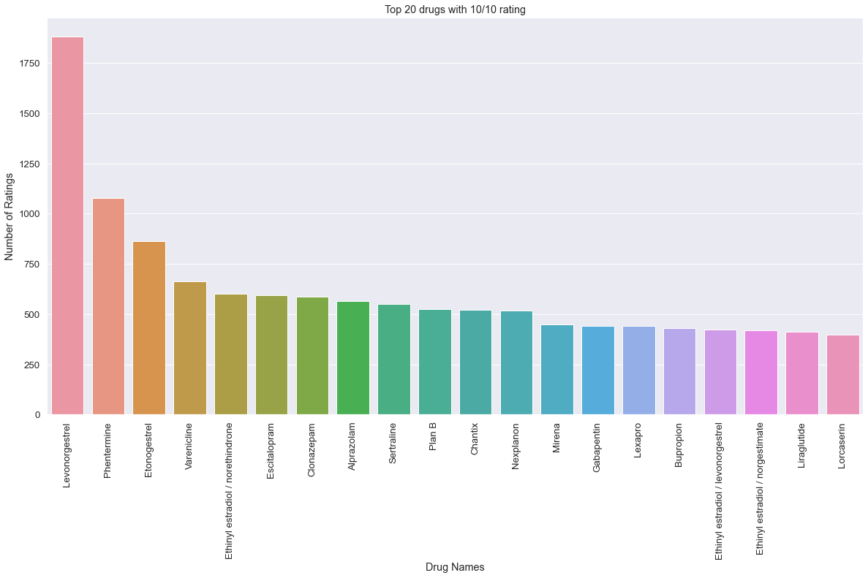
Top 20 drugs with a 10/10 rating
T

Slide 8
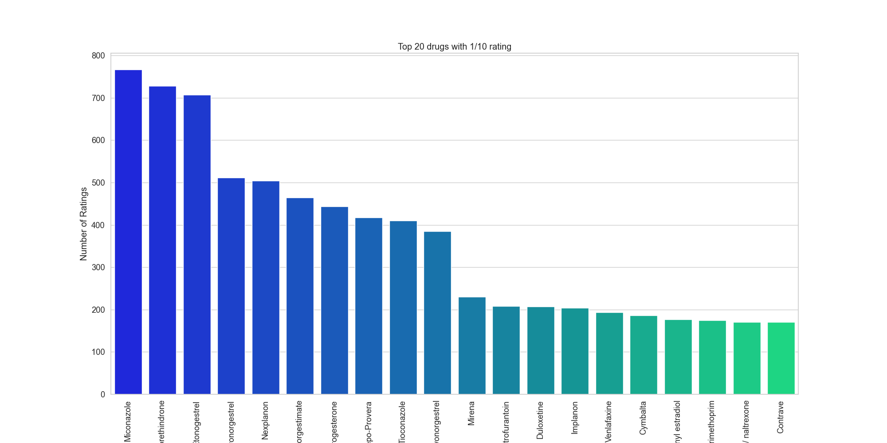
Top 20 drugs with the 1/10 rating

Slide 9
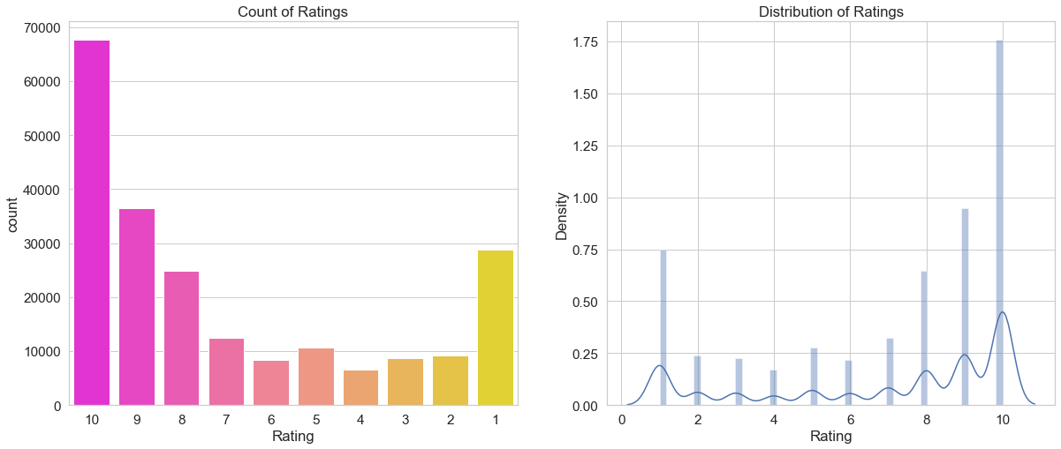
DISTRIBUTION OF THE RATING

Slide 10
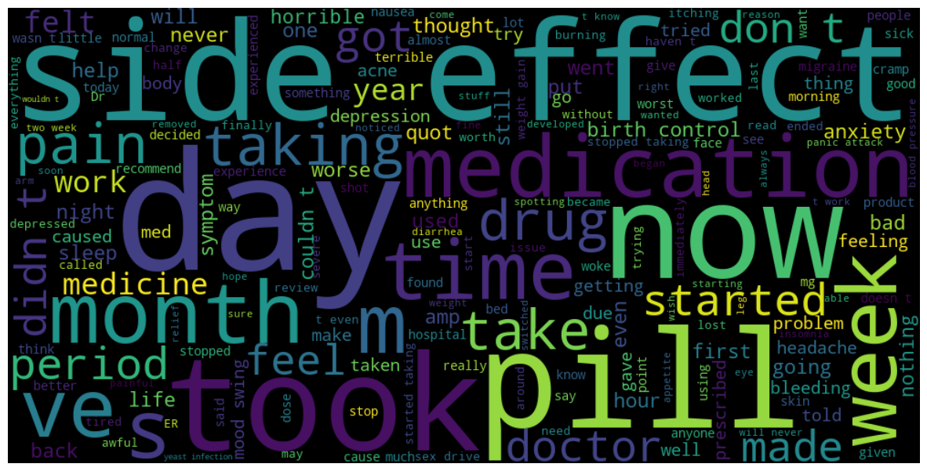
Word cloud of the reviews with rating 1/10

Slide 11
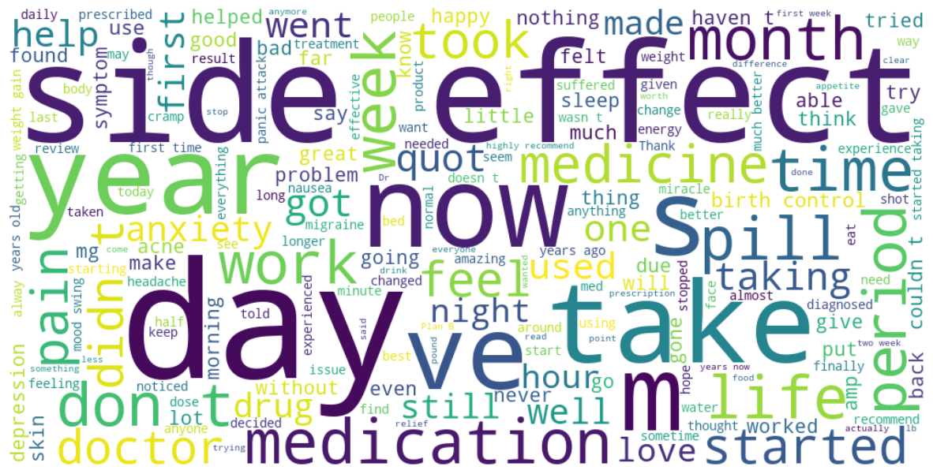
Word cloud of the reviews with rating equal to 10/10

Slide 12
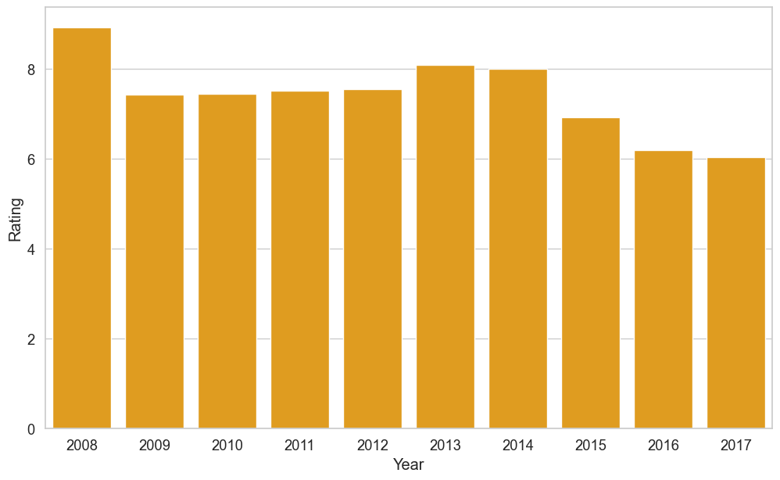
Ratings of drugs over different years.

Slide 13
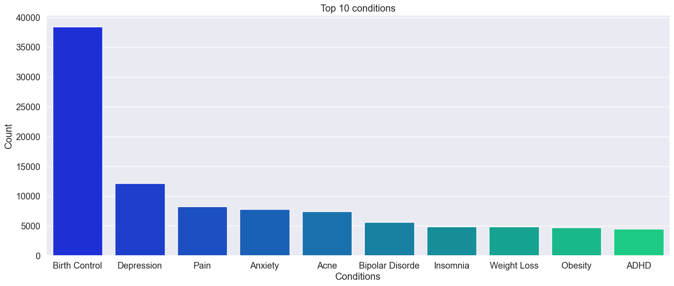
Top 10 Conditions

Slide 14
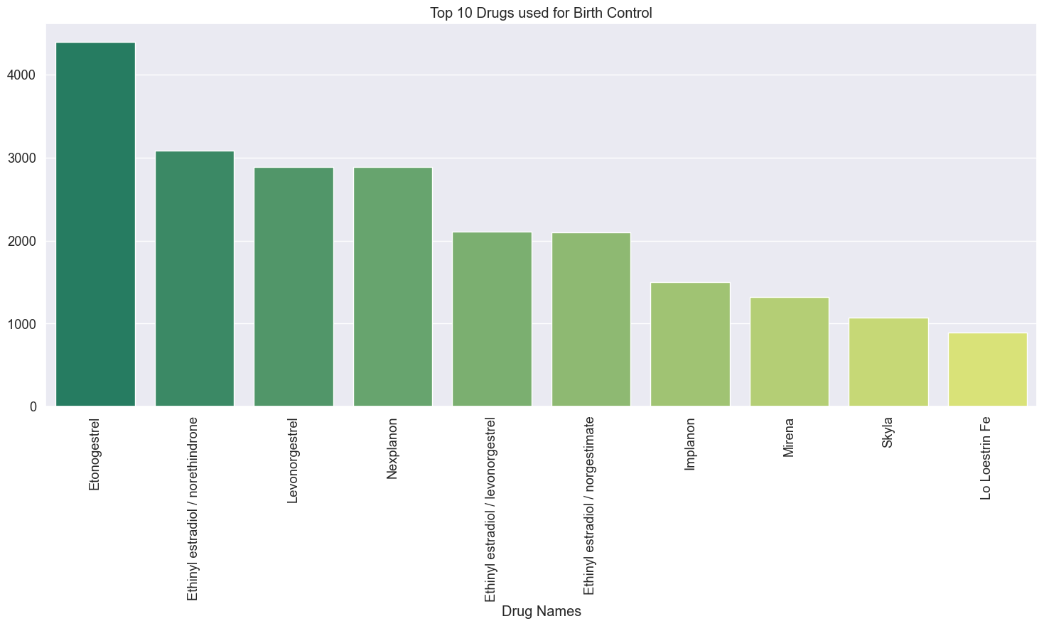
Drugs used for Birth Control

Slide 15
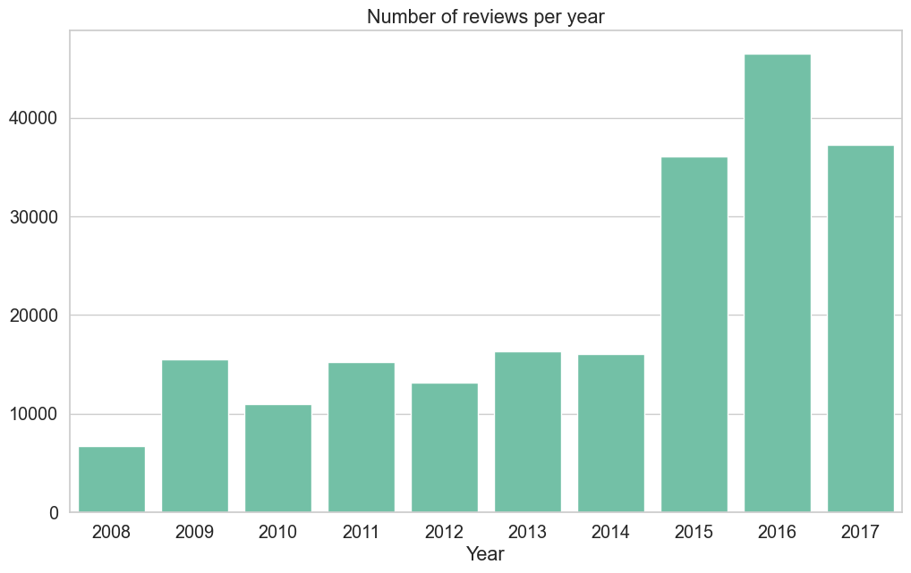

Slide 16
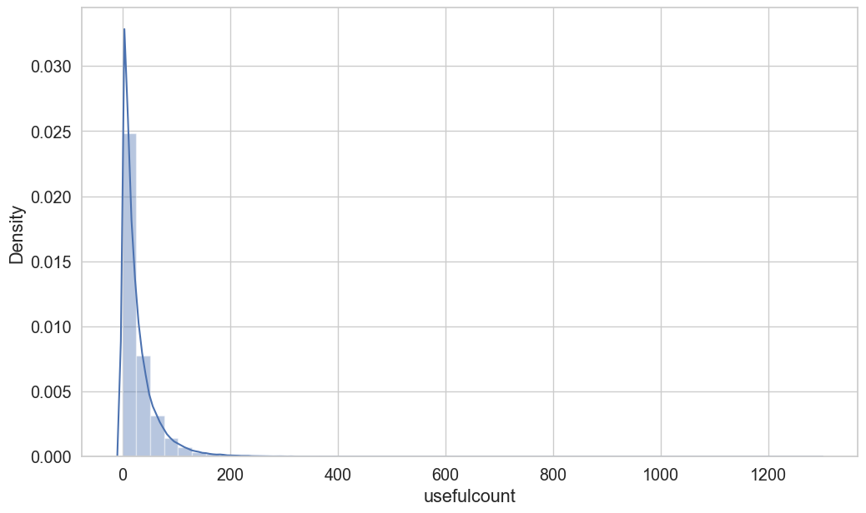
Visualization of Useful Counts

Slide 17
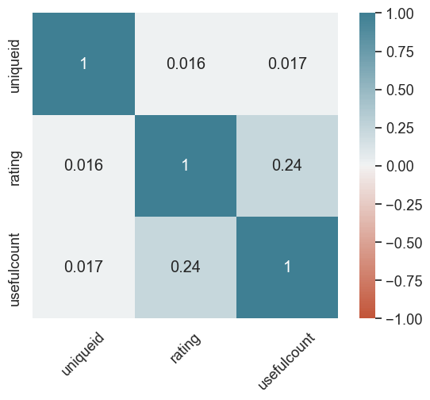
Heatmap of the Correlation Matrix

Slide 18
LABEL PREPROCESSING
Filtered out conditions with atleast 20 reviews
Undersampled condition with > 200 reviews
Filtered out labels containing numeric values

Slide 19

NLP Preprocessing
Stop Word & Punctuation:- It helps in removing frequent occurring words which do not add any value while classification.
Stemming:-It helps in removing the prefixes and suffixes of a word. for eg; “Beautiful”--→ “Beauty”
Tokenization:- It helps in splitting the text into individual words or tokens. Count vectorization converts the text data into numerical data.

Slide 20
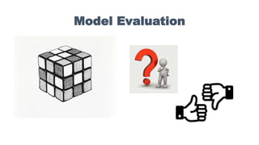

Slide 21

Classification Models
1. Random Forest.
2. KNN Classifiers
3. Multinomial Naïve Bayes
4. SGD Classifiers.

Slide 22
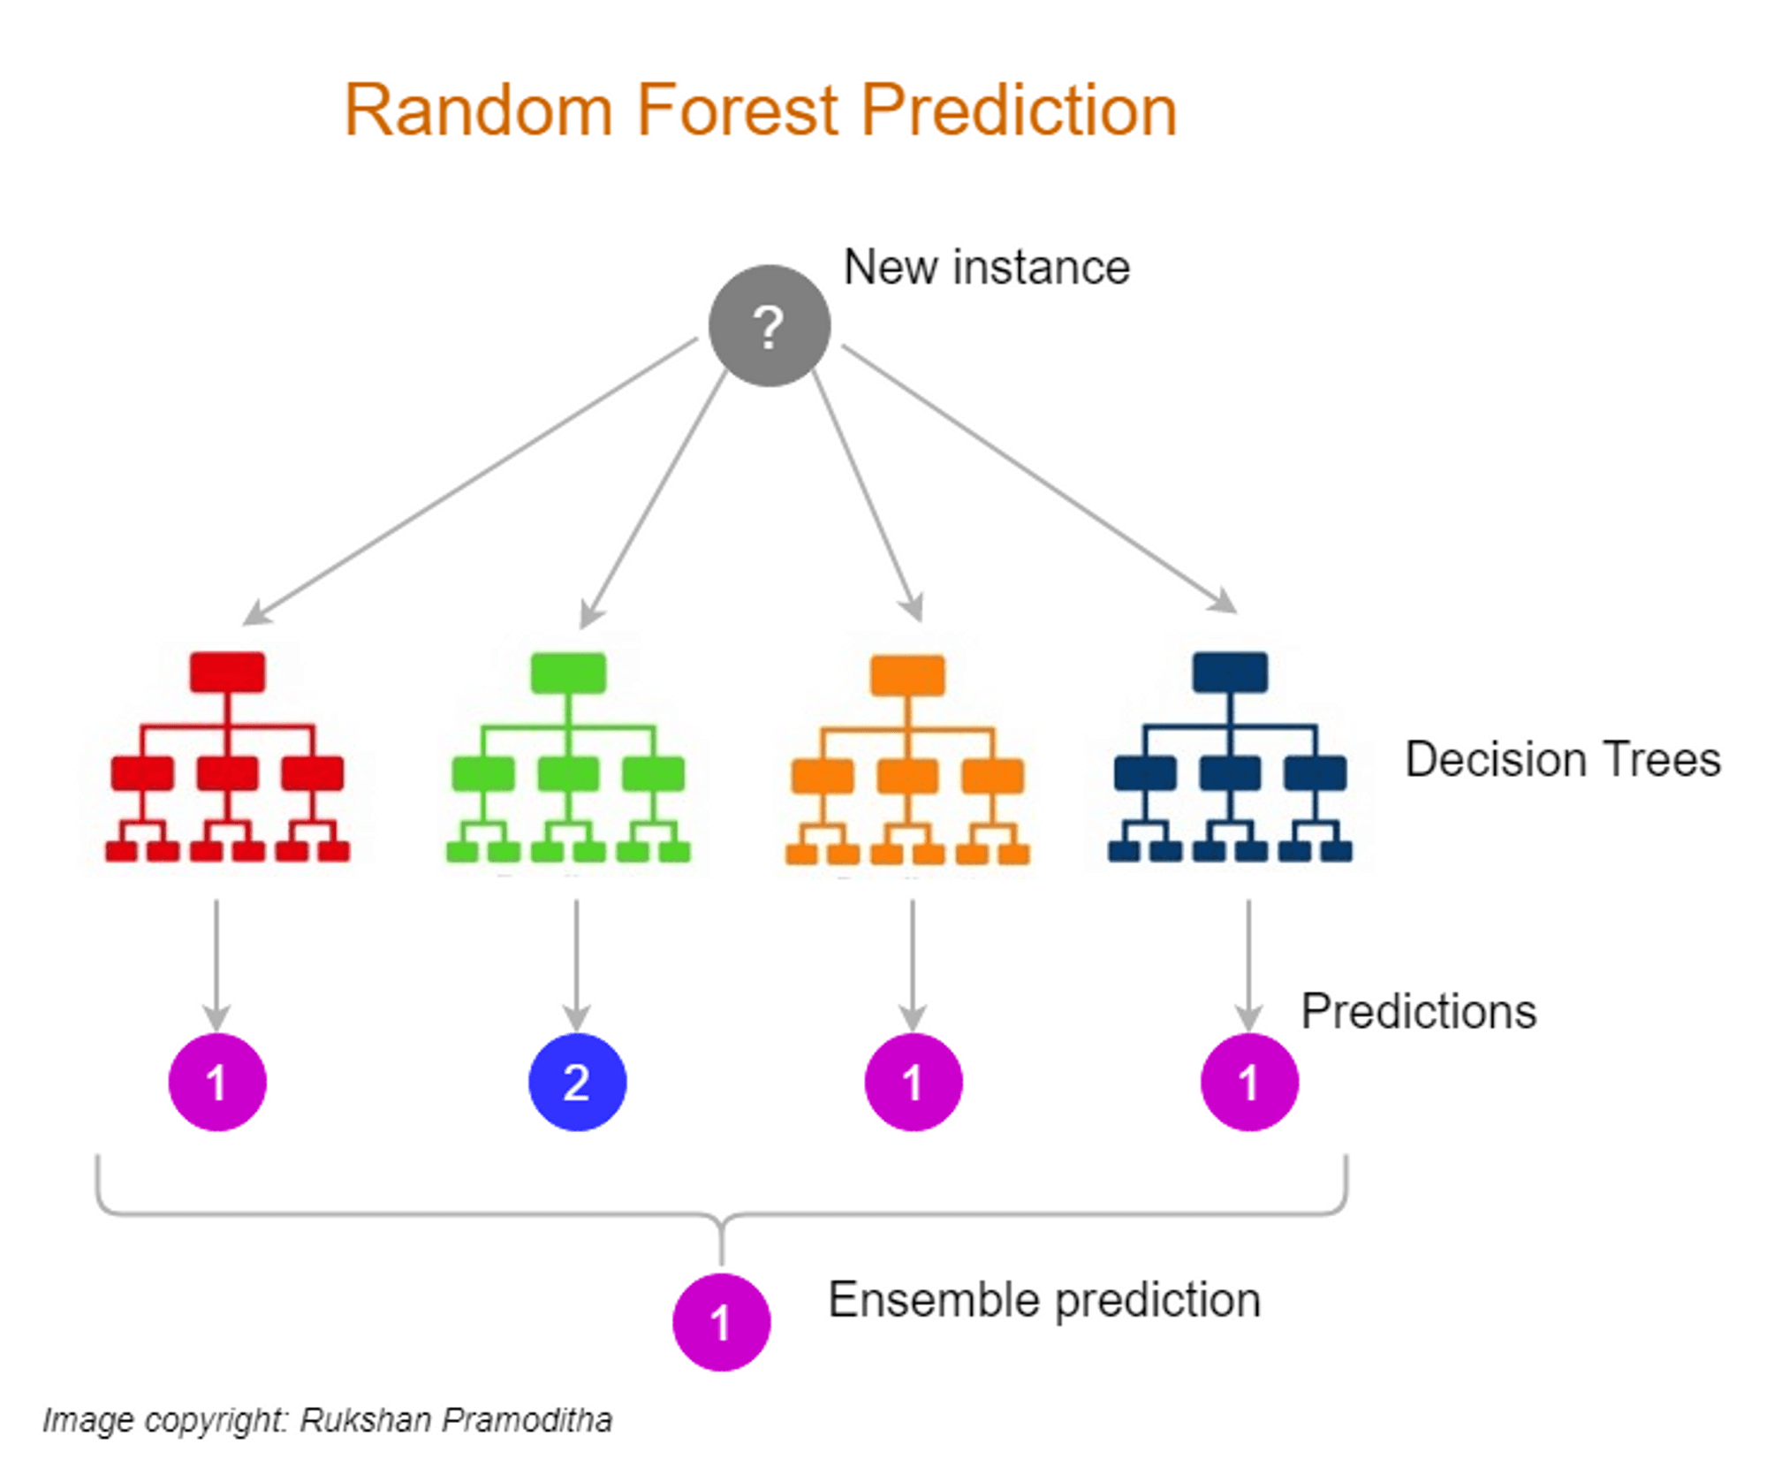

Slide 23
Results
Cross Validation Results
Model | Accuracy | Standard Deviation
Multinomial Naïve Bayes | 49% | 0.00%
SGD Classifier | 54% | 0.01%
Random Forest | 61% | 0.00%
KNN Classifiers | 06% | 0.00%
Results on test data for Random Forest
Metrics | Values
Accuracy | 54.14%
Macro F1 Score | 54.62%
Micro F1 Score | 54.14%

Slide 24

Limitations and Future Work
Sentiment Analysis on this Drug Review Dataset
Use of Deep Learning models like LSTMs and Transformers for prediction task
Robust form of NLP or Labels preprocessing to increase accuracy
Better way of tokenization to convert text to vectors

Slide 25

Thank You

